Slide 1


Introduction
Materials and Methods
Results
Discussion
Conclusion
Task 3 Forecasts / Sub-project 3.3
Exploring changes in functional diversity under climate change
Wednesday, June 7th 2023
Etienne Fort
Etienne Fort OSU Pythéas - CESAB
Impact of climate change on the functional diversity of fish communities in European waters Master 2

Slide 2
Introduction
Materials and Methods
Results
Discussion
Conclusion
1
Etienne Fort OSU Pythéas - CESAB
Impact of climate change on the functional diversity of fish communities in European waters Master 2

Slide 3
Introduction
Materials and Methods
Results
Discussion
Conclusion
Species distribution models (SDMs)
Presence threshold
Habitat suitability
Continuous indices ~ Probability (from 0 to 1)
Binomial values ~ Presence/Absence (0 or 1)
2
Etienne Fort OSU Pythéas - CESAB
Impact of climate change on the functional diversity of fish communities in European waters Master 2

Slide 4
Introduction
Materials and Methods
Results
Discussion
Conclusion
Species distribution models (SDMs)
Presence threshold
Habitat suitability
Continuous indices ~ Probability (from 0 to 1)
Binomial values ~ Presence/Absence (0 or 1)
Weigthed average by the TSS
12 Occurences
data sets
12 present data sets of predictions
5 Stastical models
5 optimization methods
2
Etienne Fort OSU Pythéas - CESAB
Impact of climate change on the functional diversity of fish communities in European waters Master 2

Slide 5
Introduction
Materials and Methods
Results
Discussion
Conclusion
Species distribution models (SDMs)
Presence threshold
Habitat suitability
Continuous indices ~ Probability (from 0 to 1)
Binomial values ~ Presence/Absence (0 or 1)
Weigthed average by the TSS
Weigthed average by the TSS
Simple mean
12 Occurences
data sets
12 present data sets of predictions
5 thresholds
1 optimal threshold
5 Stastical models
5 optimization methods
2
Etienne Fort OSU Pythéas - CESAB
Impact of climate change on the functional diversity of fish communities in European waters Master 2

Slide 6
Introduction
Materials and Methods
Results
Discussion
Conclusion
Species traits data
FishBase + PANGEA
Table 1 : Ecological traits of NeA and Meds fish of this study, adapted from McLean et al., 2019
3
Etienne Fort OSU Pythéas - CESAB
Impact of climate change on the functional diversity of fish communities in European waters Master 2
Notes:
We had no missing trait values for any of the 355 species.

Slide 7
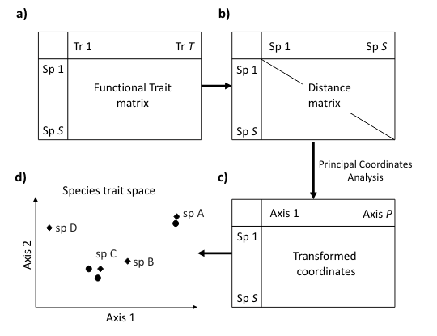
Introduction
Materials and Methods
Results
Discussion
Conclusion
Diversity indices of fish assemblages
Gower
(PCoA)
Mouillot et al., 2021
4
Etienne Fort OSU Pythéas - CESAB
Impact of climate change on the functional diversity of fish communities in European waters Master 2
Notes:
We had no missing trait values for any of the 355 species.

Slide 8
Introduction
Materials and Methods
Results
Discussion
Conclusion
Diversity indices of fish assemblages
Species richness (SR) + 6 functional diversity (FD) metrics
Table 2 : Multidimensional functional alpha-diversity indices, adapted from Magneville et al., (2022)
5
Etienne Fort OSU Pythéas - CESAB
Impact of climate change on the functional diversity of fish communities in European waters Master 2
Notes:
We had no missing trait values for any of the 355 species.

Slide 9
Introduction
Materials and Methods
Results
Discussion
Conclusion
Species distribution shift
6
Etienne Fort OSU Pythéas - CESAB
Impact of climate change on the functional diversity of fish communities in European waters Master 2

Slide 10
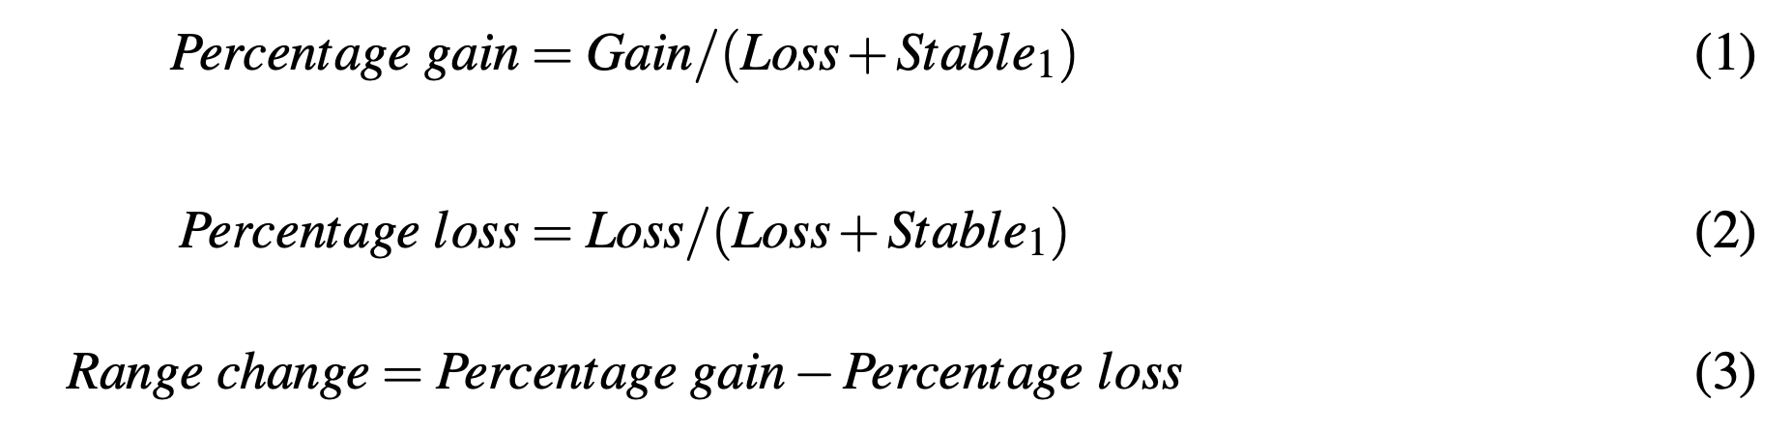
Introduction
Materials and Methods
Results
Discussion
Conclusion
Species distribution shift
6
Etienne Fort OSU Pythéas - CESAB
Impact of climate change on the functional diversity of fish communities in European waters Master 2

Slide 11
Introduction
Materials and Methods
Results
Discussion
Conclusion
Future changes of environmental conditions
Fig.1 : Maps of environmental variables evolution between present-day and 2100 according to the CMIP6 MPI-ESM1-2-HR GCM SSP-RCP 585.
7
Etienne Fort OSU Pythéas - CESAB
Impact of climate change on the functional diversity of fish communities in European waters Master 2

Slide 12
Introduction
Materials and Methods
Conclusion
Materials and Methods
Results
Results
Discussion
Habitat suitability
(Four-spot megrim)
Fig.2 : SDMs habitat suitability of Lepidorhombus boscii with the continuous predictions of both present-day and 2100 (left) and the relative shift (right).
8
Etienne Fort OSU Pythéas - CESAB
Impact of climate change on the functional diversity of fish communities in European waters Master 2

Slide 13
Introduction
Introduction
Materials and Methods
Conclusion
Materials and Methods
Results
Results
Discussion
Habitat range change
Winning and losing species
Fig.3 : Representation of the species with the 10 greatest and 10 lowest range changes out of 355 between present-day and 2100.
9
Etienne Fort OSU Pythéas - CESAB
Impact of climate change on the functional diversity of fish communities in European waters Master 2

Slide 14
Introduction
Introduction
Materials and Methods
Conclusion
Materials and Methods
Results
Results
Discussion
Habitat range change
Winning and losing species
Slender rainbow sardine
Fig.3 : Representation of the species with the 10 greatest and 10 lowest range changes out of 355 between present-day and 2100.
9
Etienne Fort OSU Pythéas - CESAB
Impact of climate change on the functional diversity of fish communities in European waters Master 2

Slide 15
Introduction
Introduction
Materials and Methods
Conclusion
Materials and Methods
Results
Results
Discussion
Habitat range change
Winning and losing species
Slender rainbow sardine
Fishline
Fig.3 : Representation of the species with the 10 greatest and 10 lowest range changes out of 355 between present-day and 2100.
9
Etienne Fort OSU Pythéas - CESAB
Impact of climate change on the functional diversity of fish communities in European waters Master 2

Slide 16
Introduction
Introduction
Materials and Methods
Conclusion
Materials and Methods
Results
Results
Discussion
Habitat range change
Winning and losing species
Slender rainbow sardine
Fishline
Sculpin fish
Fig.3 : Representation of the species with the 10 greatest and 10 lowest range changes out of 355 between present-day and 2100.
9
Etienne Fort OSU Pythéas - CESAB
Impact of climate change on the functional diversity of fish communities in European waters Master 2

Slide 17
Introduction
Materials and Methods
Conclusion
Materials and Methods
Results
Results
Discussion
Habitat range change
Spatial evolution of habitat suitability
Fig.4 : Maps depicting for each assemblage, between present-day and 2100, the number of species gain (left) and species loss (right).
10
Etienne Fort OSU Pythéas - CESAB
Impact of climate change on the functional diversity of fish communities in European waters Master 2

Slide 18
Introduction
Materials and Methods
Results
Discussion
Conclusion
Habitat range change
Relationship between the species traits and their range change
Fig.5 : Observed (dots) and modeled with a GAM (continuous) habitat range change represented in the two first axes 2-dimension functional space.
11
Etienne Fort OSU Pythéas - CESAB
Impact of climate change on the functional diversity of fish communities in European waters Master 2
Notes:
Each dot represents a species in the trait space and is associated with a color referencing their range change between present-day and 2100. Arrows represent relations between traits and PCoA axes with H: Habitat; FM: Feeding mode; ST: Spawning type.

Slide 19
Introduction
Materials and Methods
Results
Discussion
Conclusion
Habitat range change
Relationship between the species traits and their range change
Fig.6 : Relationship between habitat range change and each functional trait.
12
Etienne Fort OSU Pythéas - CESAB
Impact of climate change on the functional diversity of fish communities in European waters Master 2

Slide 20
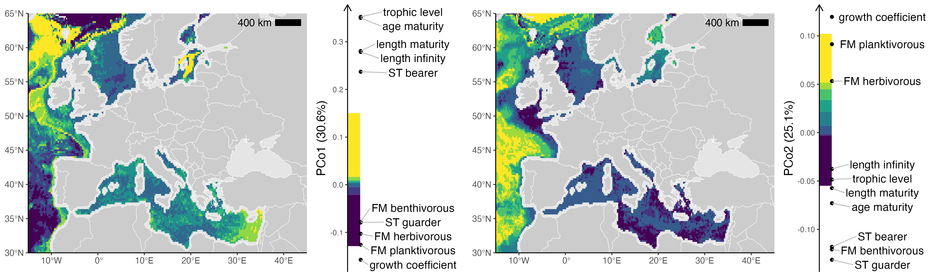
Introduction
Materials and Methods
Results
Discussion
Conclusion
Diversity of fish communties
Present spatial patterns of diversity
Fig.7 : Maps of present-day trait-based communities on both PCo1 and PCo2 related to the functional traits of the 355 species of the study.
13
Etienne Fort OSU Pythéas - CESAB
Impact of climate change on the functional diversity of fish communities in European waters Master 2

Slide 21
Introduction
Materials and Methods
Results
Discussion
Conclusion
Diversity of fish communties
Present spatial patterns of diversity
Present-day diversity metrics (modeled)
Fig.8 : Maps of diversity metrics for present-day with functional metrics from 0 to 1.
14
Etienne Fort OSU Pythéas - CESAB
Impact of climate change on the functional diversity of fish communities in European waters Master 2

Slide 22
Introduction
Materials and Methods
Results
Discussion
Conclusion
Diversity of fish communties
Temporal dynamics of diversity
Fig.9 : Functional assemblage shift on PCo1 (left) and PCo2 (right) between present-day and 2100.
15
Etienne Fort OSU Pythéas - CESAB
Impact of climate change on the functional diversity of fish communities in European waters Master 2

Slide 23
Introduction
Materials and Methods
Results
Discussion
Conclusion
Diversity of fish communties
Temporal dynamics of diversity
Fig.10 : Changes of functional identity (FIde) in the functional space between present-day and 2100
16
Etienne Fort OSU Pythéas - CESAB
Impact of climate change on the functional diversity of fish communities in European waters Master 2
Notes:
the shift of ecoregion centroid related to the functional traits.

Slide 24
Introduction
Materials and Methods
Results
Discussion
Conclusion
Diversity of fish communties
Temporal dynamics of diversity
Fig.10 : Changes of functional identity (FIde) in the functional space between present-day and 2100
16
Etienne Fort OSU Pythéas - CESAB
Impact of climate change on the functional diversity of fish communities in European waters Master 2
Notes:
the shift of ecoregion centroid related to the functional traits.

Slide 25
Introduction
Materials and Methods
Results
Discussion
Conclusion
Diversity of fish communties
Temporal dynamics of diversity
Fig.11 : Maps of diversity metrics shift between present-day and 2100.
17
Etienne Fort OSU Pythéas - CESAB
Impact of climate change on the functional diversity of fish communities in European waters Master 2

Slide 26
Introduction
Materials and Methods
Results
Discussion
Conclusion
Diversity of fish communties
Temporal dynamics of diversity
Fig.12 : Time series of diversity metrics by ecoregion between present-day and 2100.
18
Etienne Fort OSU Pythéas - CESAB
Impact of climate change on the functional diversity of fish communities in European waters Master 2

Slide 27
Introduction
Materials and Methods
Results
Discussion
Conclusion
Contrast of range change between NeA and MedS
Significant positive relationship between range change and both trophic level and growth coefficient
Homogenous distribution of the functional structure across ecoregions
19
Etienne Fort OSU Pythéas - CESAB
Impact of climate change on the functional diversity of fish communities in European waters Master 2

Slide 28
Introduction
Materials and Methods
Results
Discussion
Conclusion
Contrast of range change between NeA and MedS
Significant positive relationship between range change and both trophic level and growth coefficient
Homogenous distribution of the functional structure across ecoregions
Increase dominance of r-strategy fish in deep waters (Bay of Biscay, Iberian Coast, Oceanic Northeast Atlantic)
Increase dominance of K-strategy fish in shallow waters (Central MedS, Aegean-Levantine and Ionian Seas)
Increase dominance of r-strategy fish + homogenization in the North Sea
Deepening and polward shift of fish species
19
Etienne Fort OSU Pythéas - CESAB
Impact of climate change on the functional diversity of fish communities in European waters Master 2

Slide 29
Introduction
Materials and Methods
Results
Discussion
Conclusion
Limits
Spatial autocorrelation not taken into account
Fishing pressure not taken into account
Exclusion of food web and biotic interactions
Baltic Sea results to treat with caution
Take into account more species
Phylogenetic component not included
20
Etienne Fort OSU Pythéas - CESAB
Impact of climate change on the functional diversity of fish communities in European waters Master 2

Slide 30
Introduction
Materials and Methods
Results
Discussion
Conclusion
DONE
assess the potential effect of climate change on future taxonomic and functional diversity in European waters fish communities up to 2100
specifically answer which functional traits contribute most to overall changes in functional structure
identify combinations of trait values that will favour/disfavour species in the context of future climate change according to their distribution ecoregions
21
Etienne Fort OSU Pythéas - CESAB
Impact of climate change on the functional diversity of fish communities in European waters Master 2

Slide 31
Introduction
Materials and Methods
Results
Discussion
Conclusion
DONE
TO DO
assess the potential effect of climate change on future taxonomic and functional diversity in European waters fish communities up to 2100
specifically answer which functional traits contribute most to overall changes in functional structure
identify combinations of trait values that will favour/disfavour species in the context of future climate change according to their distribution ecoregions
Forecast species abundances using the REEF-FUTURES project, permitting to infer local fish food web structures and model a comprehensive metaweb
Include temporal environmental variability
Highlight which environmental driving forces are better predictors of the associated changes in functional structure
21
Etienne Fort OSU Pythéas - CESAB
Impact of climate change on the functional diversity of fish communities in European waters Master 2

